Slide 1
God’s Great Rescue Plan
Acts 8:26-39

Slide 2
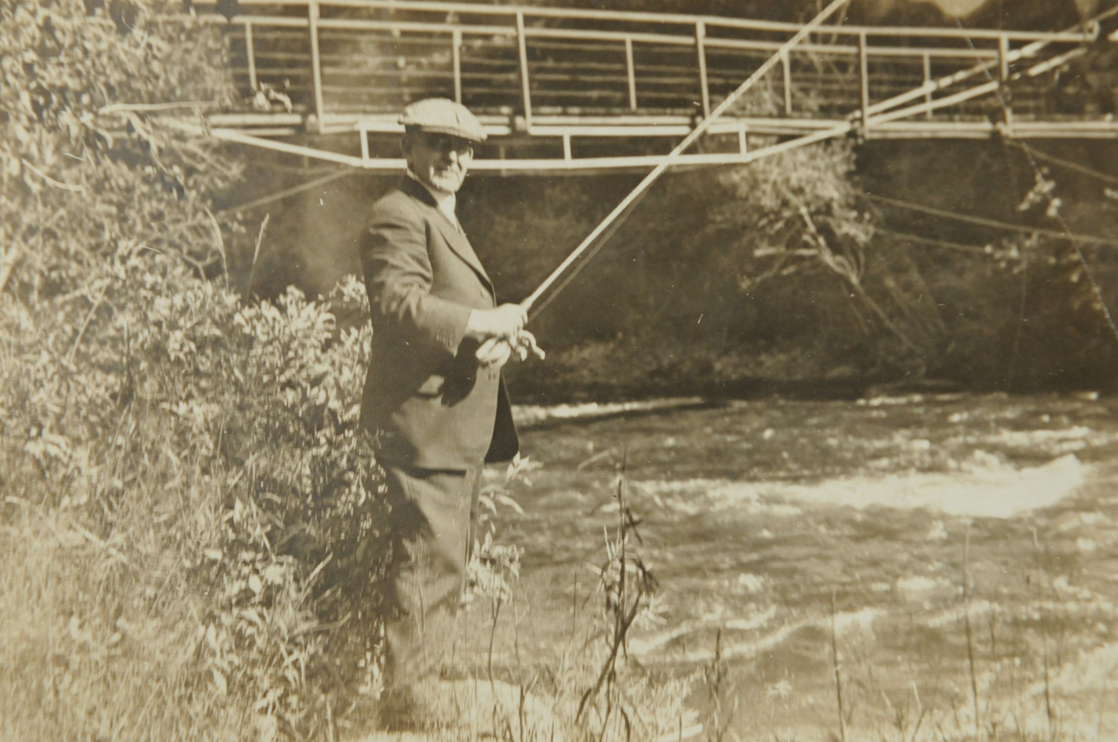

Slide 3
Principle #1 Walk with Jesus, keep a tender heart and an open ear.
Hebrews 3:7 “Therefore just as the Holy Spirit says, “Today if you hear His voice, don not harden your hearts…”

Slide 4
Principle #2 God, the Chief Shepherd, is looking for His lost sheep to rescue.
Jesus said, “The Son of Man came to seek and save that which was lost” Luke 19:10

Slide 5
Principle #3 Gospel conversations seem to always start with a question.
The Doctors role in an ER is to; Make observations, ask questions and look for vital signs. (signs of Life)
-10 ------------------------------------RC------------------------------------+10

Slide 6
Questions you can ask;
1. So tell me, where are you on your spiritual journey?
2. What was your religious background as a child?
3. What words would you use to describe your life spiritually?
4. If you died tonight how confident are you, on a scale of 1-10 that you would go to heaven? Why?
5. If you died and you stood before God and He said, “Why should I let you in to heaven?” What would you say?
6. Can I share with you about my spiritual journey?
(The Cooley ER bike shop)

Slide 8
Principle #4 As believers we need to always be ready.
“TOOLS” help us be ready to have a Gospel conversation.
Two very important tools we have in sharing the Gospel
1. Our testimony, 3-5 min. (Paul used his all the time)
2. Knowing how to use a Gospel track. (One Verse Evangelism)
“…if you confess with your mouth Jesus as Lord and believe in your heart that God raised Him from the dead you shall be saved; for with the heart man believes, resulting in righteousness and with the mouth he confesses resulting in salvation.” Romans 10:9-10

Slide 10
Principle #5 God has called us to be co-labors in His Great Rescue Plan.
I Timothy 1:12 “I thank Christ Jesus our Lord, who has strengthened me, because He considered me faithful, putting me into service.”

Slide 11
Application:
1. Be Filled with the Spirit
2. Be Looking for people God wants you to talk with
3. Be ready to start a conversation by asking simple
questions
4. Be ready to share the GOSPEL in a clear way
Work on your Testimony
Work on presenting the Gospel

